Slide 1

CEDAR RAPIDS AREA CYBER CLUB / 2026–2027
vm destruct-a-rama, vm no-create-o,
bitwarden, and hans' home network
the day proxmox stood still
2026-10-03
CEDAR RAPIDS AREA
4000hmSk1llz
Lt. club • cyber defense
2026–2027 edition
mentors: sql slth | chad | karl | jon | jimmy | josh | and a host of isaacs
direct queries (at) sql-slth on github, it's a website.

Slide 2
CEDAR RAPIDS AREA CYBER CLUB / 2026–2027
What happened during our meeting today
01
Why? Why? Why? See "Why?" to the right.
• We deleted all of last year's VMs
• Each of us created a new Ubuntu VM
• Each of us created a free Bitwarden account
• Or at least that was what was supposed to happen
WHY?
Proxmox was no match for the sheer volume of requests we were able to generate.
Team 5: 1
Proxmox: 0
CEDAR RAPIDS AREA / 4000hmSk1llz

Slide 3
CEDAR RAPIDS AREA CYBER CLUB / 2026–2027
The best-slain plans
02
"The best laid schemes o’ Mice an’ Men gang aft agley." Robert Burns
WHAT WE EXPECTED
WHAT ACTUALLY HAPPENED
• We would remove VMs and they would just go bye-bye real quick like
• Each of us would create an Ubuntu VM
• Each of us would create a Bitwarden account
• We removed VMs and they took forever to go bye-bye
• Our VM builds were backed up by the VM removals (lock contention)
• We created Bitwarden accounts, as planned
CEDAR RAPIDS AREA / 4000hmSk1llz

Slide 4
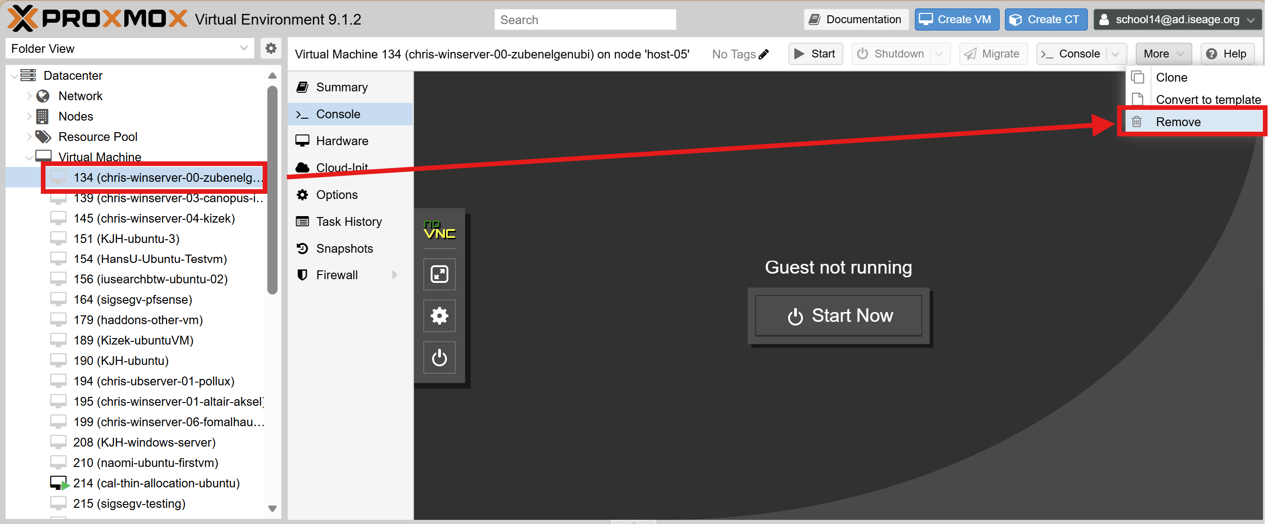
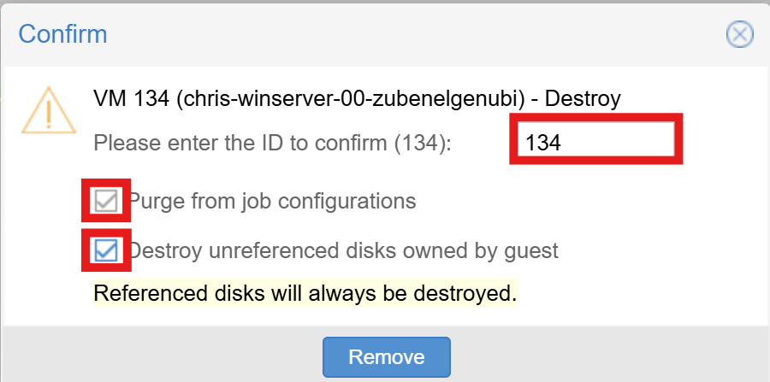
CEDAR RAPIDS AREA CYBER CLUB / 2026–2027
Removing a VM in Proxmox
03
Time to clean up last year's leftovers
1. Login to https://playground.iseage.org
2. Go to the Virtual Machines list
3. Click one of the VMs on the left. Details:
- Stop it it is not already stopped
- Click the More button on the upper-right
- Choose Remove
- Enter the VM's ID to verify the action
- Check the two check boxes:
- Purge from job configurations
- Destroy unreferenced disks owned by guest
- Click Remove
CEDAR RAPIDS AREA / 4000hmSk1llz

Slide 5
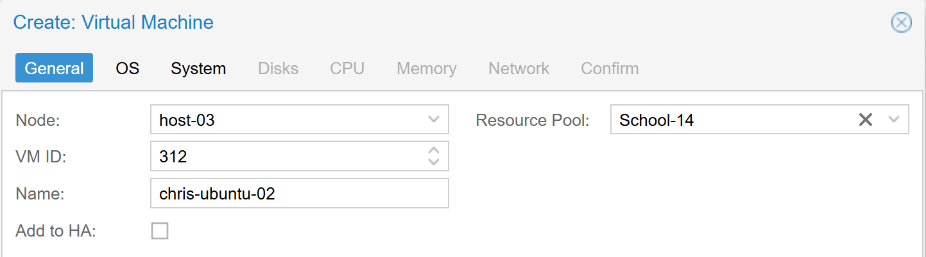
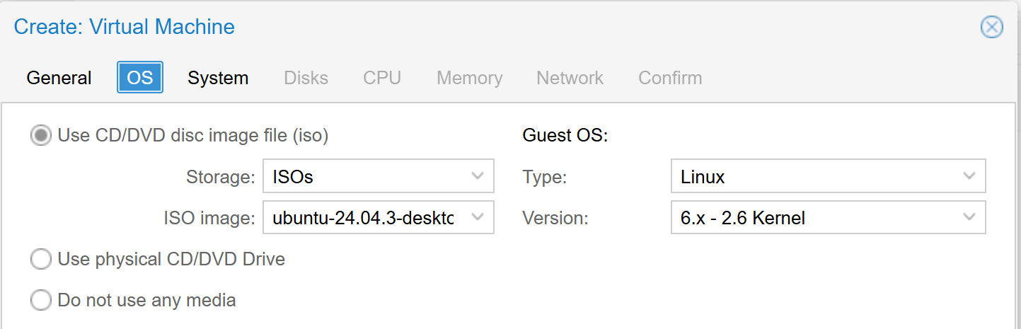
CEDAR RAPIDS AREA CYBER CLUB / 2026–2027
Building a new VM in Proxmox
04
Time to bring Proxmox to its knees
1. Click the Create VM button
2. On the General tab, set the following values and then click Next:
- Resource Pool: School-14
- Name: <firstname>-<OS>-<index>
- Examples:
chris-ubuntu-01
chris-ubuntu-02
chris-windows-01
3. On the OS tab, set the following values and then click Next:
- SELECT: Use CD/DVD disk image file (iso)
- Storage: ISOs
- ISO image: ubuntu-24.04.3-desktop-amd64.iso
- Type: Linux
- Version: 6.x – 2.6 Kernel
CEDAR RAPIDS AREA / 4000hmSk1llz

Slide 6
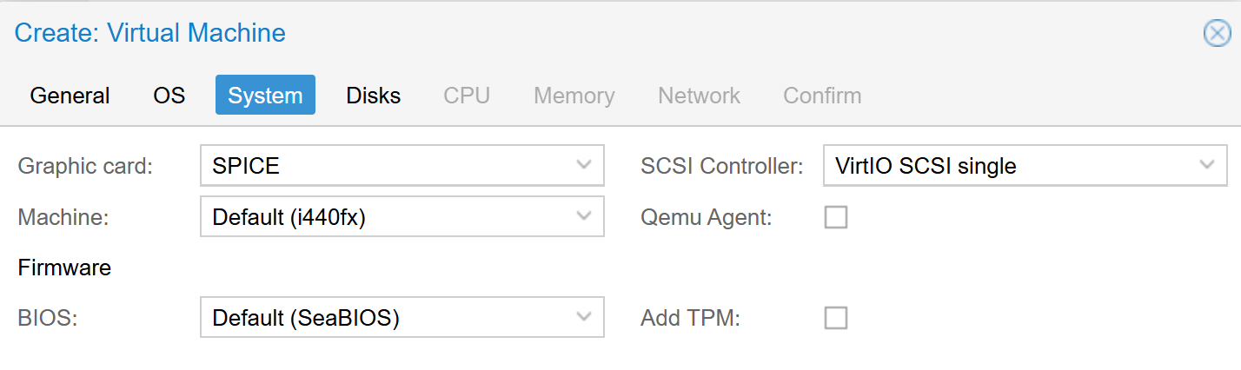
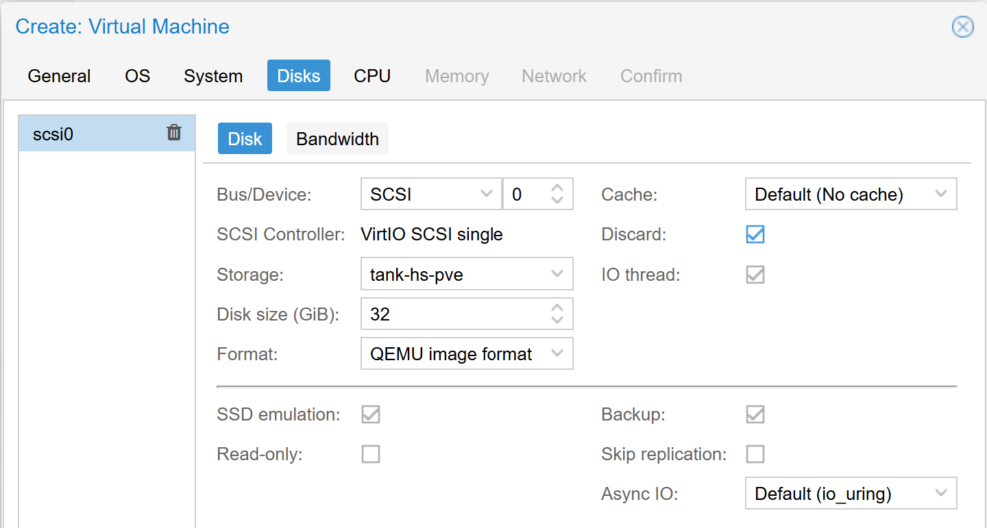
CEDAR RAPIDS AREA CYBER CLUB / 2026–2027
Building a new VM in Proxmox
05
Time to bring Proxmox to its knees
4. On the System tab, set the following values and then click Next:
- Graphic card: SPICE
- Leave all others at their default values
5. On the Disks tab, set the following values and then click Next:
- SELECTED: SSD Emulation
- SELECTED: Discard
- Leave all others at their default values
CEDAR RAPIDS AREA / 4000hmSk1llz

Slide 7
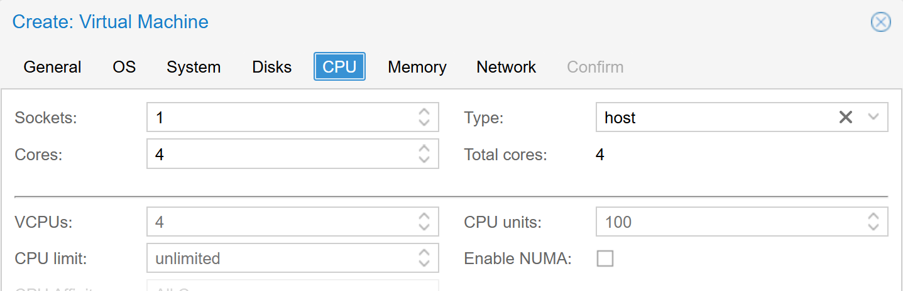
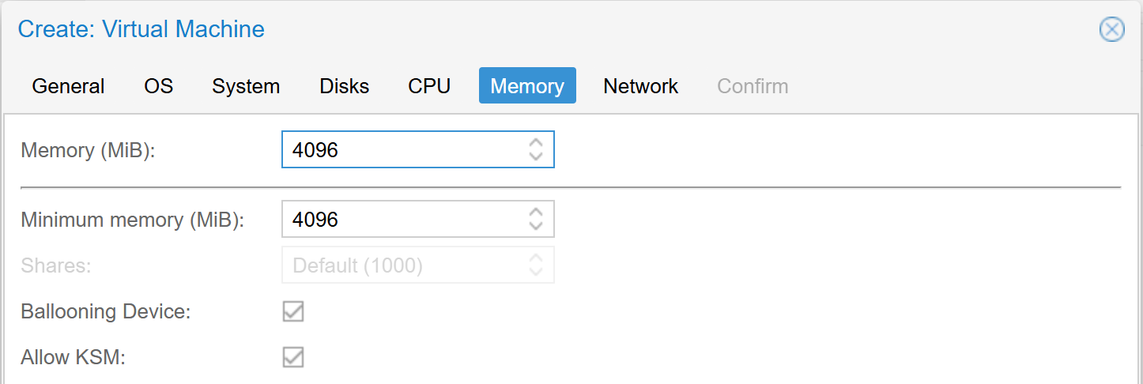
CEDAR RAPIDS AREA CYBER CLUB / 2026–2027
Building a new VM in Proxmox
06
Time to bring Proxmox to its knees
6. On the CPU tab, set the following values and then click Next:
- Sockets: 1
- Cores: 4
- Type: host
- Leave all others at their default values
7. On the Memory tab, set the following values and then click Next:
- Memory (MiB): 4096
- Minimum memory (MiB): 4096
- Leave all others at their default values
CEDAR RAPIDS AREA / 4000hmSk1llz

Slide 8
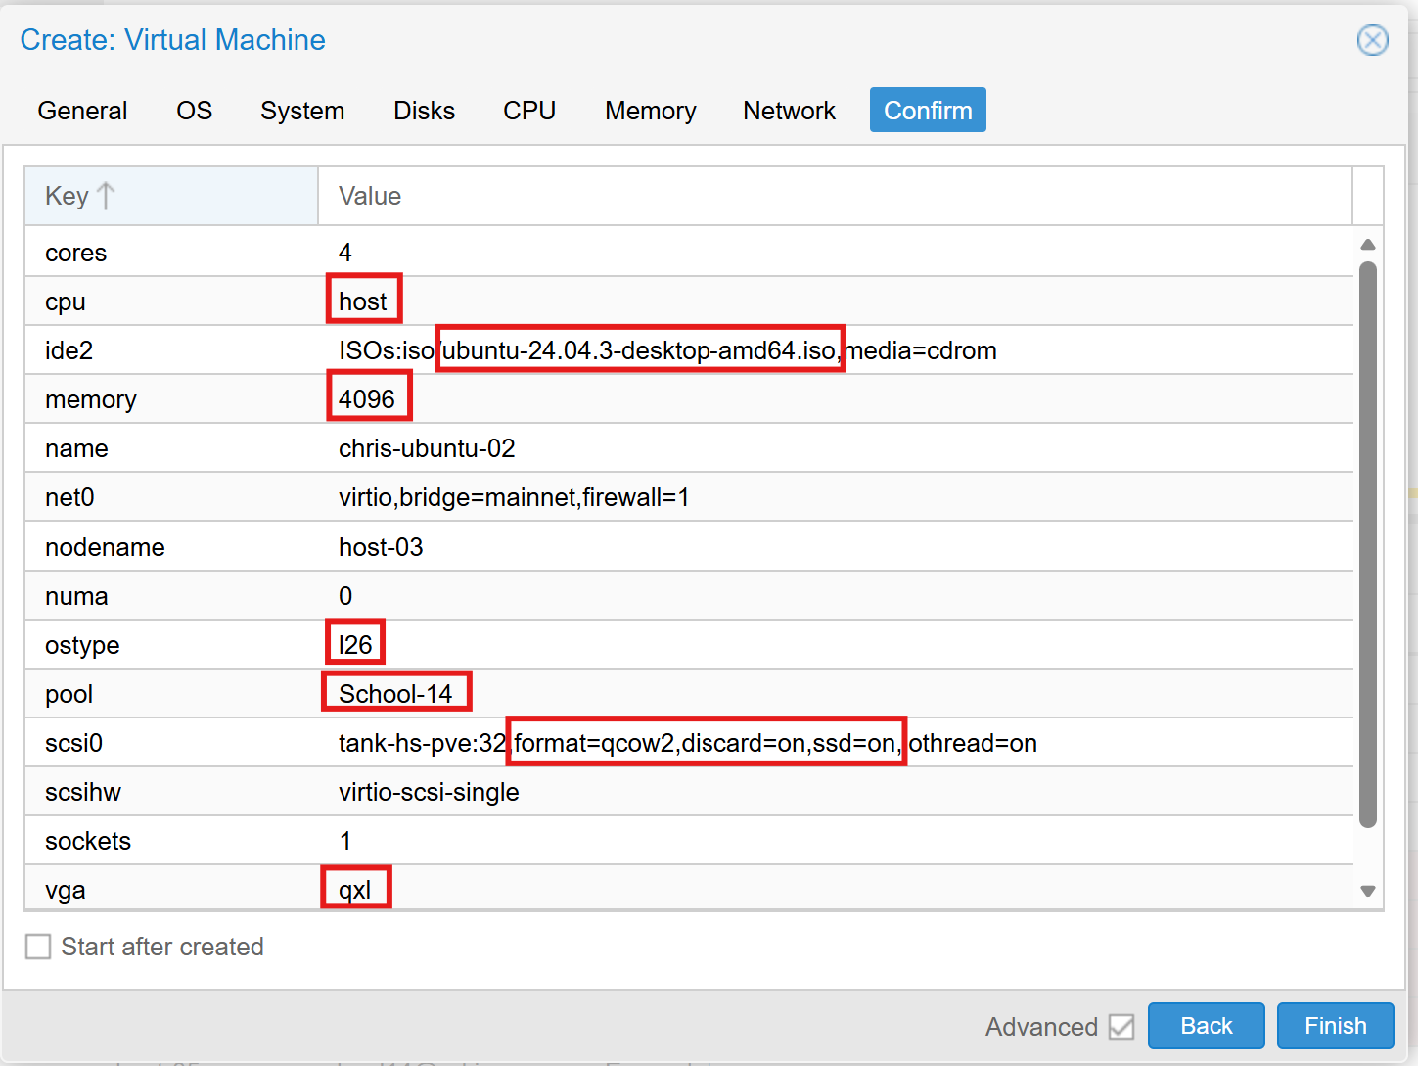
CEDAR RAPIDS AREA CYBER CLUB / 2026–2027
Building a new VM in Proxmox
07
Time to bring Proxmox to its knees
8. Don't make any changes on the Network tab. Just click Next.
9. On the Confirm tab, make sure that all the choices listed there match these instructions. When you are satisfied that they do, click Finish, and job will be scheduled to build your VM.
CEDAR RAPIDS AREA / 4000hmSk1llz

Slide 9
CEDAR RAPIDS AREA CYBER CLUB / 2026–2027
Obtaining a Bitwarden account
08
Why did the bit warden go to jail? Answers on the right.
• Everybody made a Bitwarden account to store their passwords this year
• In case you weren't here, this is what to do:
Go to https://bitwarden.com/pricing/
Scroll down to the button that says Create Free Account
Click the button and follow the flow to create your account
Add the extension to your browser
Why did the bit warden
go to jail?
Possession with intent to autofill
Caught red-handed with All The Keys
Flipping bits without a warrant
Repeated jailbreaks
Guilty of unauthorized access
Reversible hashing (sha2)
Making jokes worse than these (I'm not sure that's possible?)
CEDAR RAPIDS AREA / 4000hmSk1llz

Slide 10
CEDAR RAPIDS AREA CYBER CLUB / 2026–2027
Obtaining a Bitwarden account
08
Why did the bit warden go to jail? Answers on the right.
After your account is created, add our School14 credentials to your Bitwarden account. Use the following values:
  Item name: ISEAGE playground school14
  Folder: No folder
  Username: school14
  Password: DvbA18agWX
  Website (URI): https://playground.iseage.org
If everything's right, Bitwarden should offer to fill in credentials whenever you visit the ISEAGE playground.
  Ask in Zulip if you need help
Why did the bit warden
go to jail?
Possession with intent to autofill
Caught red-handed with All The Keys
Flipping bits without a warrant
Repeated jailbreaks
Guilty of unauthorized access
Reversible hashing (sha2)
Making jokes worse than these (I'm not sure that's possible?)
CEDAR RAPIDS AREA / 4000hmSk1llz

